Slide 1
Progress Meeting

Slide 2
Overview
What I did in the past weeks
MADDPG
Recurrent PPO
Submission CAGE 4
The problems
Recurrent PPO
Future work
Recurrent PPO
QMIX
Work on CybORG

Slide 3
MADDPG
Rationale:
Actor-Critic Approach
Improve a target policy (different from the currently used policy to select actions)
Target network gets copied periodically
Centralized training with decentralized execution
General Results:

Slide 4
MADDPG
Rationale:
Actor-Critic Approach
Improve a target policy (different from the currently used policy to select actions)
Target network gets copied periodically
Centralized training with decentralized execution
General Results:
Overall mixed results reported for this method
Baseline implementation – Continuous action space
Gumbel-Softmax – Allows us to sample discrete actions from the policy
Alternatives: GST (Shown to have lower variance)

Slide 5
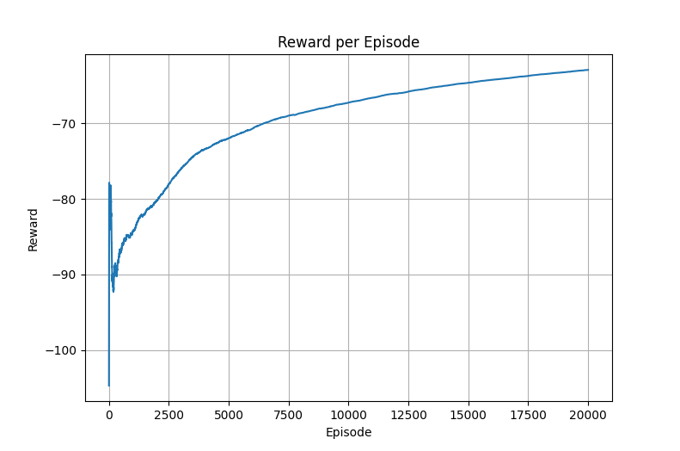
MADDPG - Results

Slide 6
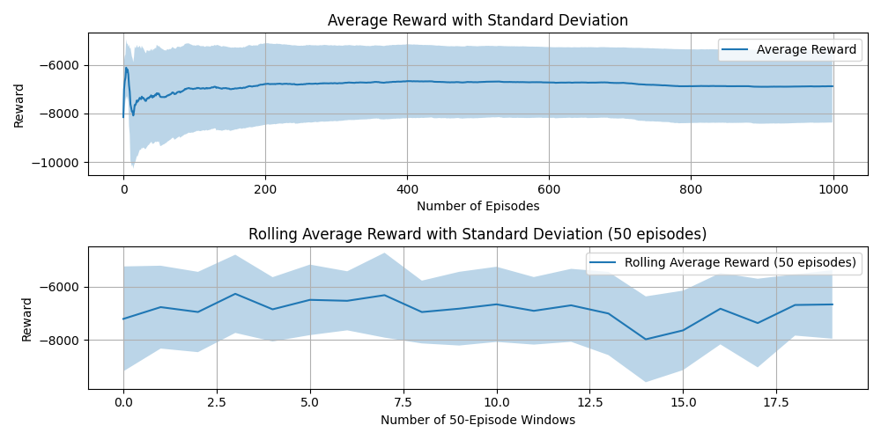
MADDPG - Results

Slide 7
Recurrent PPO
Rationale:
Use an LSTM layer in the Actor and Critic architecture
Initialize hidden and cell state of LSTM with 0s (Reset that at each episode)
Collect trajectories and current hidden states (use current hidden states to choose actions and critic values)
Reconstruct LSTM state during training
Positive findings:
Can help in POMDP environments
Can help in environments where actions have a temporal dependency

Slide 8
Recurrent PPO - Problems
Problems:
Reconstruction phase
Hidden state used in training
Architecture
Initialization
Trajectory collection (Reshape data)
Initial problem: Not clean split into episodes
Memory not padded – Sequence lenght = Length of longest episode
Solutions (?):
Possible problem with the learning phase
Check the graph backpropagation
Reconstruct the full
Problem with the reconstruction of the hidden state during training:
Problem with the learning phase: hidden states are not passed correctly

Slide 9
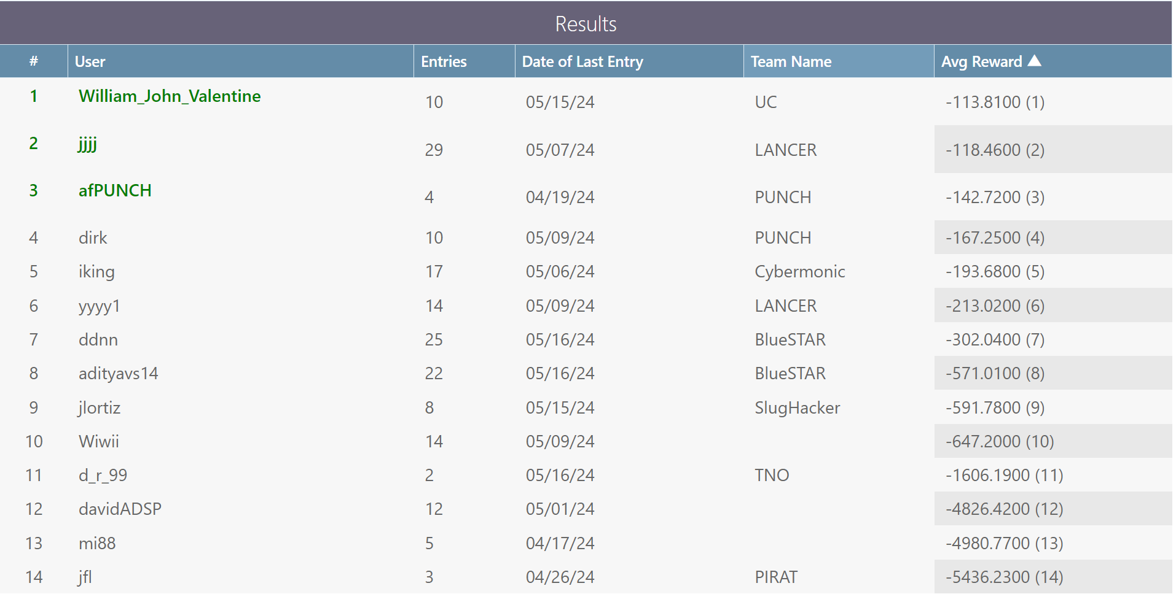
CAGE 4

Slide 10
Our Results
Baseline IPPO with larger batch size yielded more consistent and better results: AVG – (1500-1700)
Test other methods with larger batch sizes as well:
MAPPO (+Messages)
Test 8 bits messages
Recurrent PPO and QMIX can possibly improve the results further

Slide 11
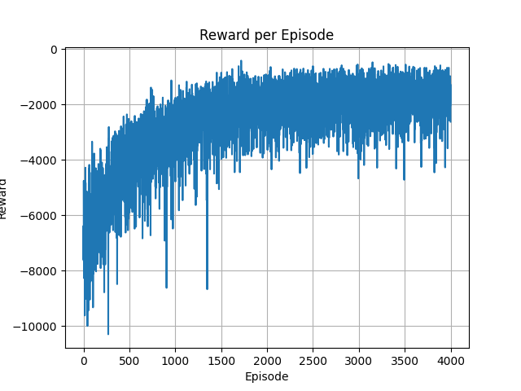
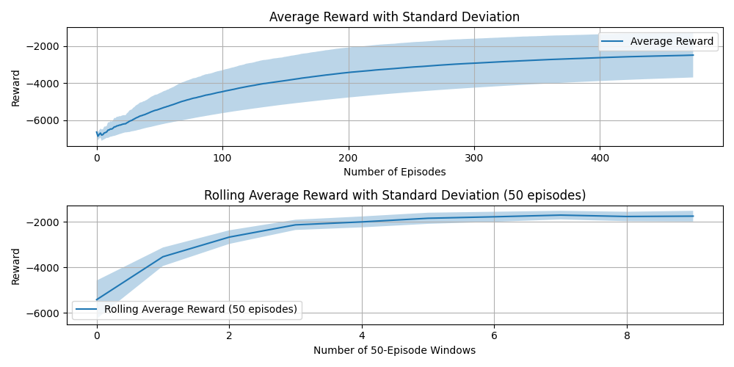
PPO – Larger batch size

Slide 12
Messages
To test: 8 Bits version
Alternative:
Problem with MARL is non stationarity of the environment
Agents: Send messages about their chosen action
Problem: Would it fit an actual use case?
Would operators in a security center disclose their actions?

Slide 13
Immediate future work
(Hopefully) Finish and test recurring PPO
Test MADDPG with different HP
Test messages again
2 and 8 bit
Continue to implement QMIX
Adds a Mixer network – Takes into consideration the joint action values of the agents
Write Results section in June, Keep working on Methods.

Slide 14
Future work to discuss
Working on methods now – Writing partial results in June
Future works w.r.t CybORG (July Onwards):
Change connectivity of the network
Reshape the reward, state and action calculation accordingly.
Implement RL based attackers
The number of attackers is variable: Would this work?
Test different agents organizations:
Multiple agents in subnetwork (HQ Network) – How can they coordinate?
Would the rewards improve or not?

Slide 15
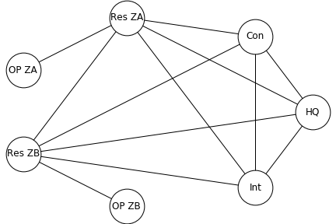
Works on the environment
Current Network Topology (when no connection is blocked)
Similar to a ‘Mesh Topology’ (each device connected to each others)
What if we change this to a ‘Star Topology’?

Slide 16
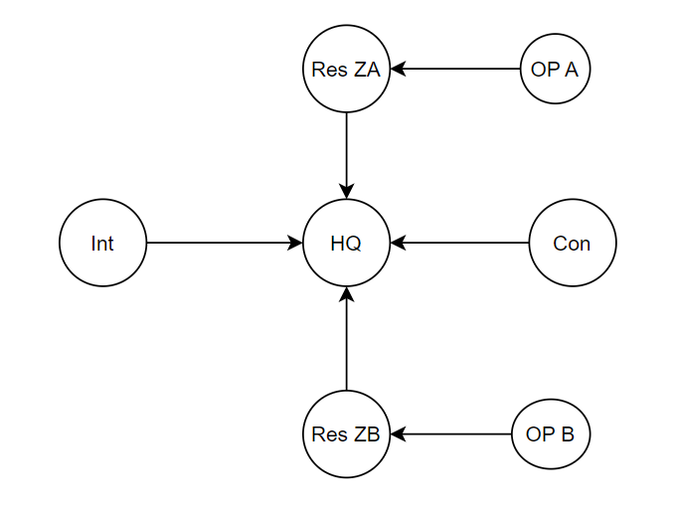
Works on the environment
Current Network Topology (when no connection is blocked)
Similar to a ‘Mesh Topology’ (each device connected to each others)
What if we change this to a ‘Star Topology’?
Puts pressure on the HQ network
Reshape reward accordingly
How do the agents action change
Combined with testing different agents organizations

